Slide 1
LCD
AVR Session

Slide 2
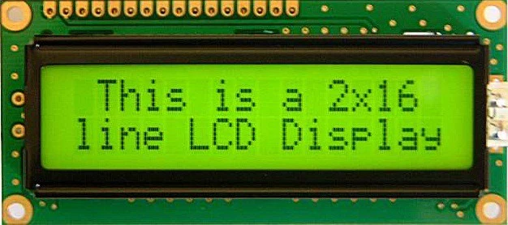
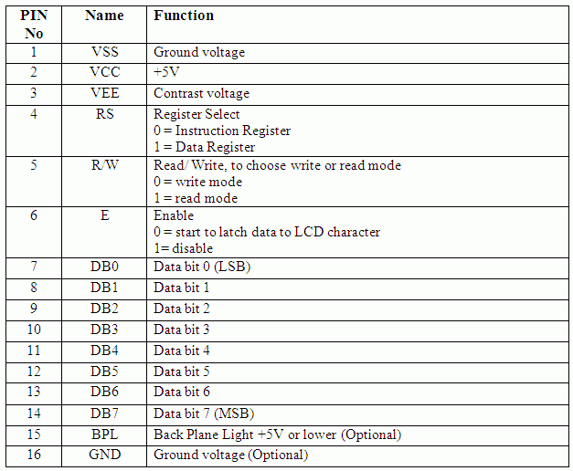
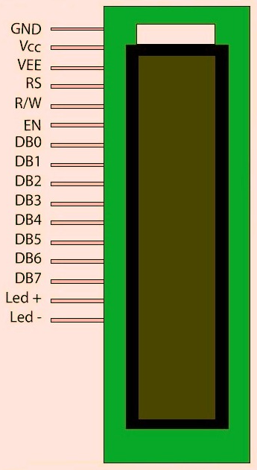
What is an LCD?

Slide 3
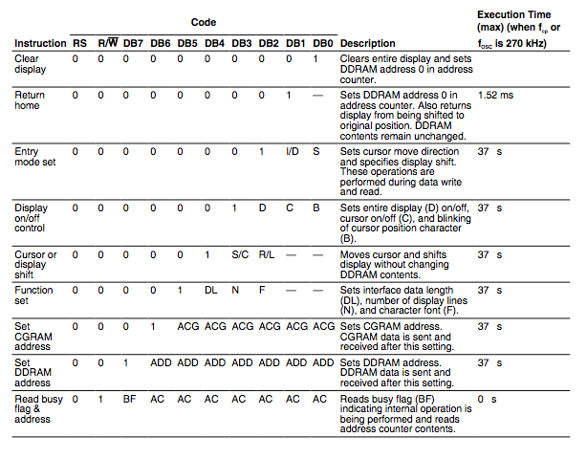
The Instruction Set

Slide 4
How to control LCD
The uC sends commands to the LCD by setting RS, RW, and DB0...DB7 to specific values
What data to send for each command is given in the Instruction Set.
Fortunately people have mapped each instruction to a C function and provided it in a header file, so we don’t have to remember the instruction code or keep referring to the instruction set.
So, we will be using this header file “lcd.h”

Slide 5
Example Code:
#include <avr/io.h>
#include <avr/delay.h>
#include “lcd.h”
int main(){
LCD_init();
LCD_write(“Hello AVR”); // You can write strings
LCD_putchar(“!”); // You can also write single characters
_delay_ms(3000); // Display text for 3s
LCD_wait(); // Waits until any previous command finishes, LCD is free
LCD_command(0x01); // This is how you send commands
// This command will clear the screen
// Look it up in the Instruction Set
LCD_write(“Elec Club rocks!”);
while(1);
return 0;
}

Slide 6
We can implement functions of our own too!
.
.
.
void LCD_clrscr(){
LCD_wait();
LCD_command(0x01);
}
int main(){
...
LCD_clrscr(); // Now you don’t need to remember 0x01 represents clear screen! :D
...
}
This is essentially what “lcd.h” does. Open the file and see its contents! Try to understand the various functions by seeing what command they send and looking up the Instruction Sheet!

Slide 7
Let’s implement a function by looking up the Instruction Sheet now!
lcd.h does not have an important function which moves cursor to a position (x,y). We will try to implement that. Each block in the LCD which displays a character is represented by a DDRAM block. Hence to set the cursor position we need to set the DDRAM address.
Lets look at the Instruction Sheet.

Slide 8
We need to set DB7 to 1 and DB6...DB0 to the address we want.
The addresses of 16x2 LCD are 0...15 for the first line and 64...79 for the second line. 16 characters per line. So lets write our function.
void LCD_cursor_goto(int x, int y){
char addr = 0x80; // Set DB7 to 1
if(y==1)
addr = addr + 0x40; // Start counting from 64(0x40) for line 2
addr = addr + x; // Finally add x position to get address
LCD_wait(); // wait until any previous command finishes
LCD_command(addr); // Send command to LCD
}

